Slide 1
Operations with matrices
Modelling linear systems of equations. Application

Slide 2

What is a matrix?

Slide 3
Example
Matrices appear in different contexts. We have seen previously that matrices in their augmented form can abbreviate a linear system of equations. Matrices also appear in the context of representing all types of sets of data collected from real life.
For instance, the sales of different types of 2 l bottled beverages from 3 stores during a 1 hour period could be represented in the form of a table as shown below:
 | Store A | Store B | Store C
Pepsi | 46 | 27 | 53
Coke | 27 | 59 | 34

Slide 4
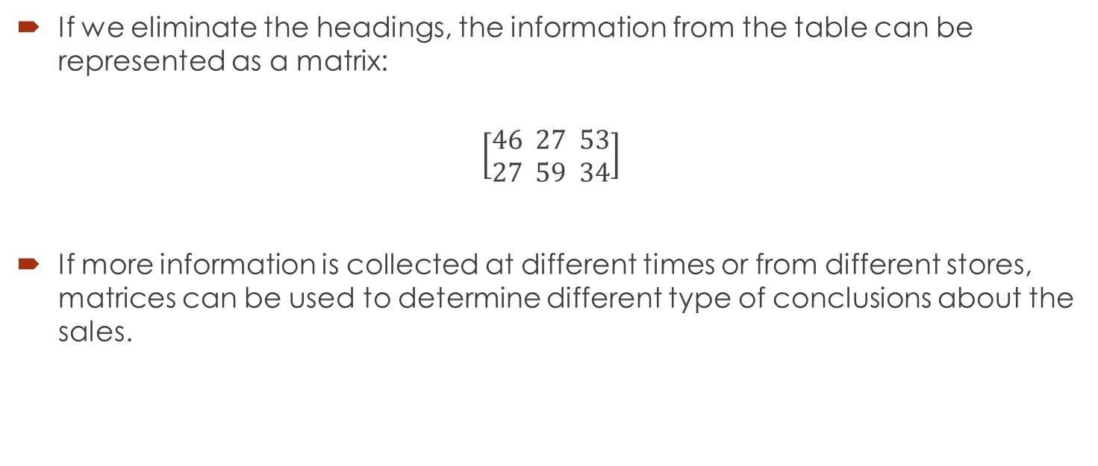
Convert the information into a matrix
If we eliminate the headings, the information from the table can be represented as a matrix:
$$\left[\begin{aligned}46 27 53 \\ 27 59 34\end{aligned}\right]$$
If more information is collected at different times or from different stores, matrices can be used to determine different type of conclusions about the sales.

Slide 5

Types of matrices (by size)
A general m x n matrix (m rows and n columns) can be written as:
$$A=\left[\begin{matrix}a_{11} & ⋯ & a_{1n} \\ ⋮ & ⋱ & ⋮ \\ a_{m1} & ⋯ & a_{mn}\end{matrix}\right]$$
A compact notation can be also used: ${\left[a_{ij}\right]}_{m×n}$.

Slide 6
A square matrix is a matrix with n rows and n columns.

Slide 7
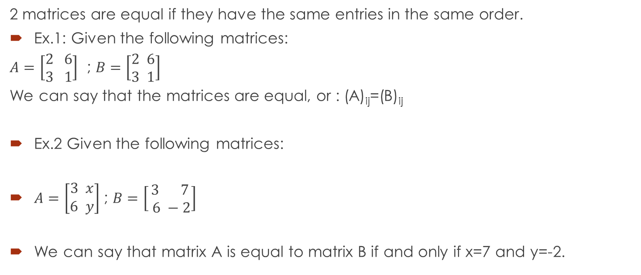
1. Equal matrices
2 matrices are equal if they have the same entries in the same order.
Ex.1: Given the following matrices:
$A=\left[\begin{aligned}2 6 \\ 3 1\end{aligned}\right]$ ; $B=\left[\begin{aligned}2 6 \\ 3 1\end{aligned}\right]$
We can say that the matrices are equal, or : (A)_{ij}=(B)_{ij}
Ex.2 Given the following matrices:
$A=\left[\begin{aligned}3 x \\ 6 y\end{aligned}\right]$ ; $B=\left[\begin{aligned}3 7 \\ 6 −2\end{aligned}\right]$
We can say that matrix A is equal to matrix B if and only if x=7 and y=-2.

Slide 8
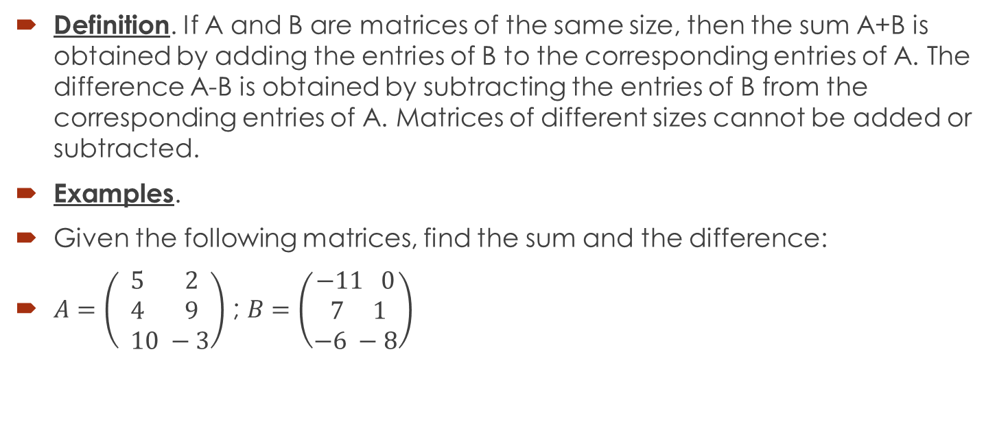
2. Addition and subtraction of matrices
Definition. If A and B are matrices of the same size, then the sum A+B is obtained by adding the entries of B to the corresponding entries of A. The difference A-B is obtained by subtracting the entries of B from the corresponding entries of A. Matrices of different sizes cannot be added or subtracted.
Examples.
Given the following matrices, find the sum and the difference:
$A=\left(\begin{aligned}5 2 \\ 4 9 \\ 10 −3\end{aligned}\right)$ ; $B=\left(\begin{aligned}−11 0 \\ 7 1 \\ −6 −8\end{aligned}\right)$

Slide 9

The sum is:
$\left(\begin{aligned}5 2 \\ 4 9 \\ 10 −3\end{aligned}\right)+\left(\begin{aligned}−11 0 \\ 7 1 \\ −6 −8\end{aligned}\right)=\left(\begin{aligned}−6 2 \\ 11 10 \\ 4 −11\end{aligned}\right)$
The difference is:
$\left(\begin{aligned}5 2 \\ 4 9 \\ 10 −3\end{aligned}\right)−\left(\begin{aligned}−11 0 \\ 7 1 \\ −6 −8\end{aligned}\right)= \left(\begin{aligned}16 2 \\ −3 8 \\ 16 5\end{aligned}\right)$

Slide 10
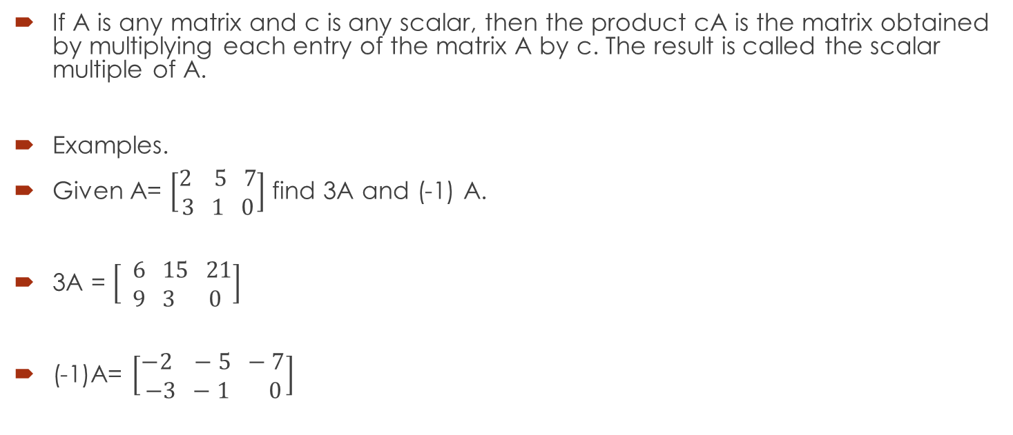
3. Multiplying a matrix by a scalar
If A is any matrix and c is any scalar, then the product cA is the matrix obtained by multiplying each entry of the matrix A by c. The result is called the scalar multiple of A.
Examples.
Given A= $\left[\begin{aligned}2 5 7 \\ 3 1 0\end{aligned}\right]$ find 3A and (-1) A.
3A = $\left[\begin{aligned} 6 15 21 \\ 9 3 0\end{aligned}\right]$
(-1)A= $\left[\begin{aligned}−2 −5 −7 \\ −3 −1 0\end{aligned}\right]$

Slide 11
4. Multiplying 2 matrices
If A is a m x r matrix and B is a r x n matrix, then the product AB is a m x n matrix. To find the entries of AB, multiply the corresponding entries of the rows of A to the entries of the columns of B and add them together.

Slide 12

Example
Given the following matrices, find their product.
$A=\left[\begin{aligned}2 5 1 \\ 3 1 −2\end{aligned}\right]$ ; B=$\left[\begin{aligned}4 1 0 −2 \\ 2 3 1 0 \\ 4 2 5 −1\end{aligned}\right]$

Slide 13

Answer:
AB= $\left[\begin{aligned}22 19 10 −5 \\ 6 2 −9 −4\end{aligned}\right]$

Slide 14
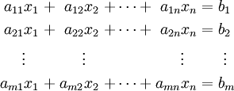
Theorem. If A is an m x n matrix, and x is a nx1 column vector, then the product Ax can be expressed as a linear combination of the column vectors of A in which the coefficients are the entries of x.
In case of a linear system of the form:

Slide 15
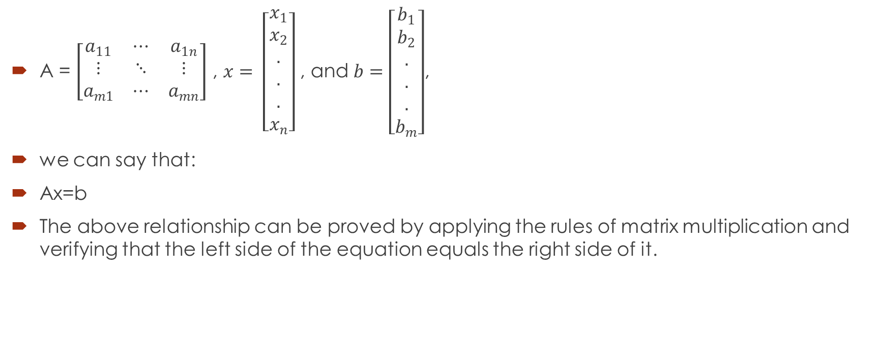
Where:
A = $\left[\begin{matrix}a_{11} & ⋯ & a_{1n} \\ ⋮ & ⋱ & ⋮ \\ a_{m1} & ⋯ & a_{mn}\end{matrix}\right]$ , $x= \left[\begin{aligned}x_{1} \\ x_{2} \\ . \\ . \\ . \\ x_{n}\end{aligned}\right]$ , and $b=\left[\begin{aligned}b_{1} \\ b_{2} \\ . \\ . \\ . \\ b_{m}\end{aligned}\right]$,
we can say that:
Ax=b
The above relationship can be proved by applying the rules of matrix multiplication and verifying that the left side of the equation equals the right side of it.

Slide 16
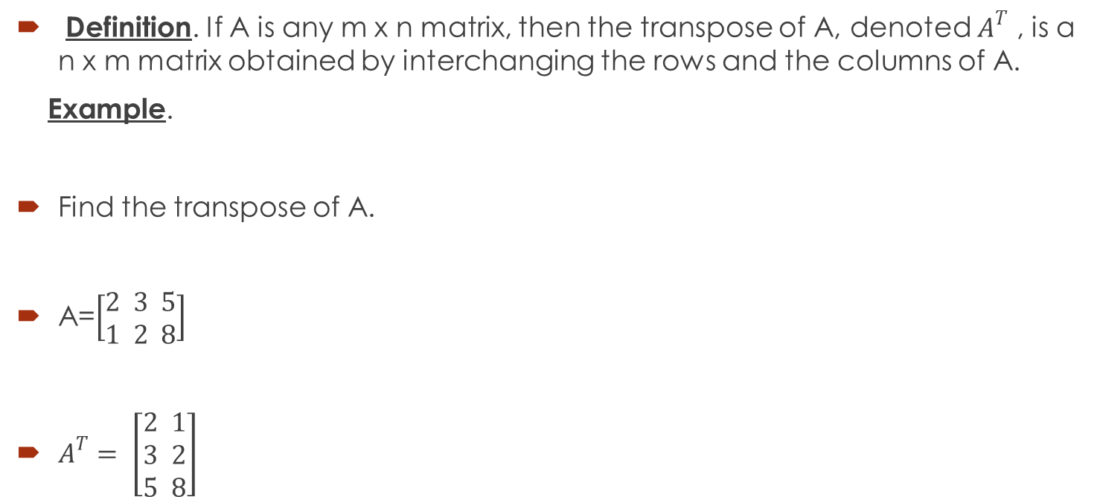
5. The transpose of a matrix
Definition. If A is any m x n matrix, then the transpose of A, denoted $A^{T}$ , is a n x m matrix obtained by interchanging the rows and the columns of A.
Example.
Find the transpose of A.
A=$\left[\begin{aligned}2 3 5 \\ 1 2 8\end{aligned}\right]$
$A^{T}= \left[\begin{aligned}2 1 \\ 3 2 \\ 5 8\end{aligned}\right]$

Slide 17
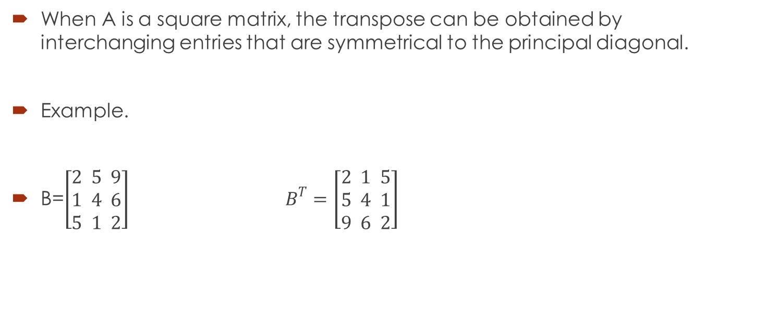
Special case
When A is a square matrix, the transpose can be obtained by interchanging entries that are symmetrical to the principal diagonal.
Example.
B=$\left[\begin{aligned}2 5 9 \\ 1 4 6 \\ 5 1 2\end{aligned}\right]$ $B^{T}=\left[\begin{aligned}2 1 5 \\ 5 4 1 \\ 9 6 2\end{aligned}\right]$

Slide 18
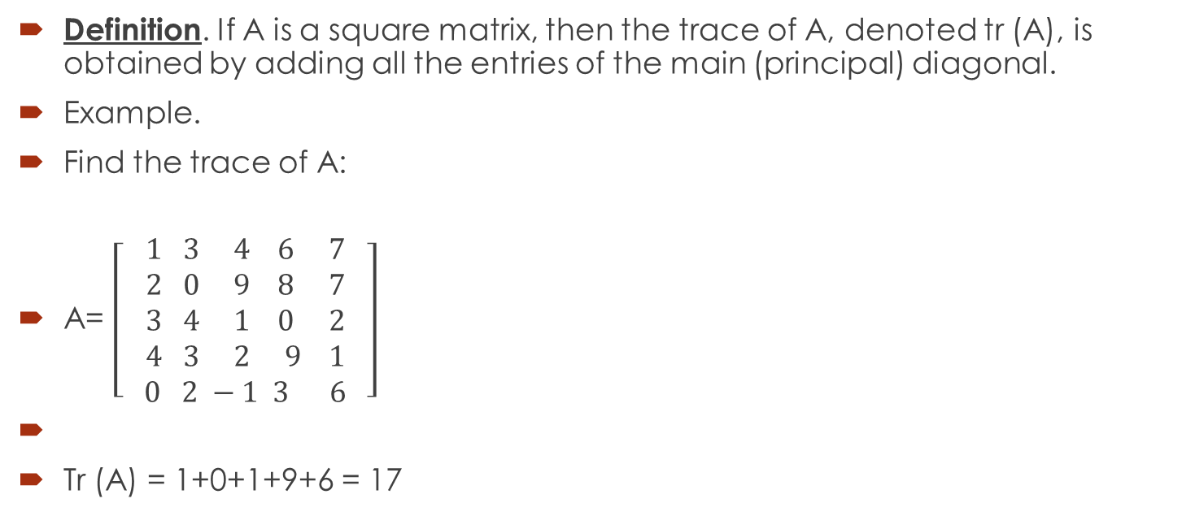
6. The trace of a matrix
Definition. If A is a square matrix, then the trace of A, denoted tr (A), is obtained by adding all the entries of the main (principal) diagonal.
Example.
Find the trace of A:
A= $\left[\begin{aligned}1 3 4 6 7 \\ 2 0 9 8 7 \\ 3 4 1 0 2 \\ 4 3 2 9 1 \\ 0 2 −1 3 6 \end{aligned}\right]$
Tr (A) = 1+0+1+9+6 = 17

Slide 19
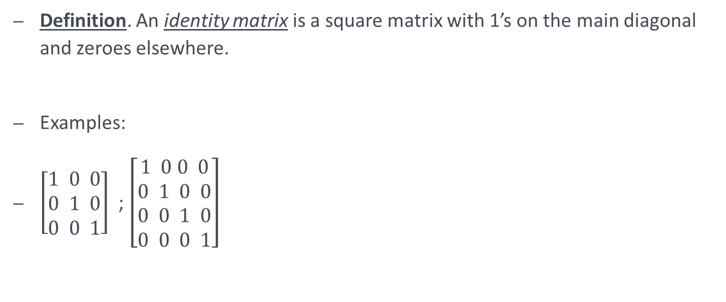
The identity matrix

Slide 20
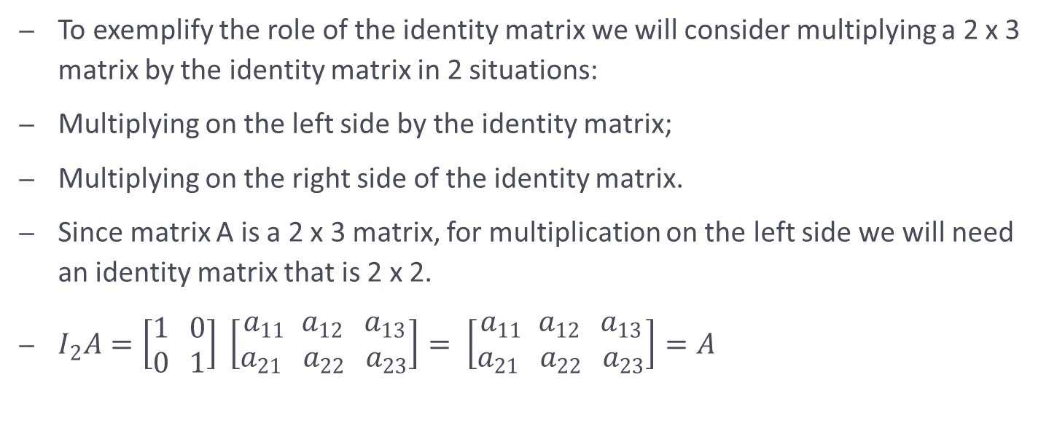
The role of an identity matrix

Slide 21
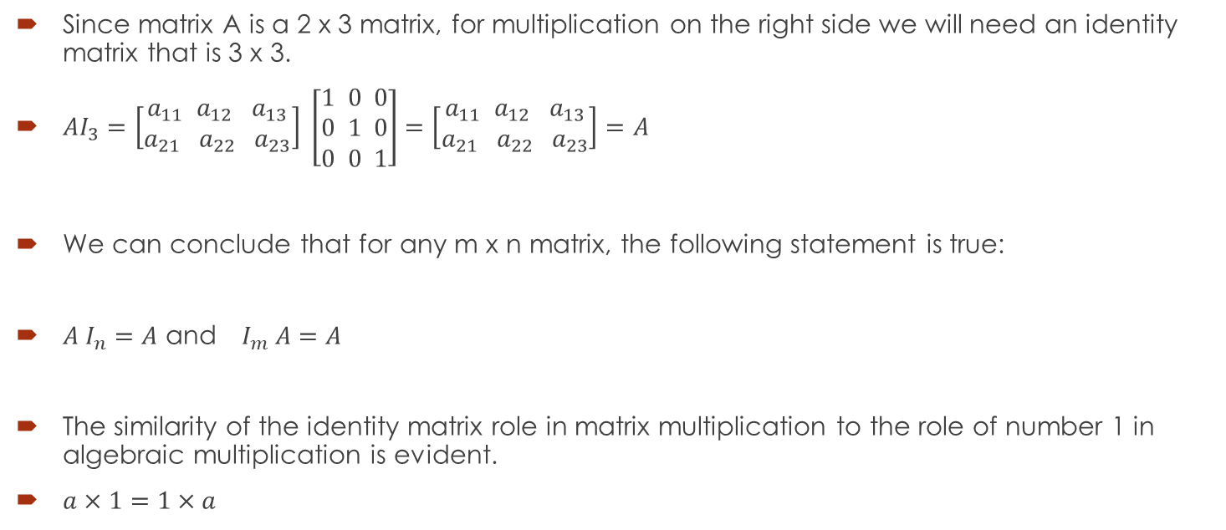
Since matrix A is a 2 x 3 matrix, for multiplication on the right side we will need an identity matrix that is 3 x 3.
$AI_{3}=\left[\begin{aligned}a_{11 }a_{12} a_{13} \\ a_{21} a_{22} a_{23}\end{aligned}\right] \left[\begin{aligned}1 0 0 \\ 0 1 0 \\ 0 0 1\end{aligned}\right]=\left[\begin{aligned}a_{11 }a_{12} a_{13} \\ a_{21} a_{22} a_{23}\end{aligned}\right]=A$
We can conclude that for any m x n matrix, the following statement is true:
$A I_{n}=A$ and $I_{m} A=A$
The similarity of the identity matrix role in matrix multiplication to the role of number 1 in algebraic multiplication is evident.
$a×1=1×a$

Slide 22
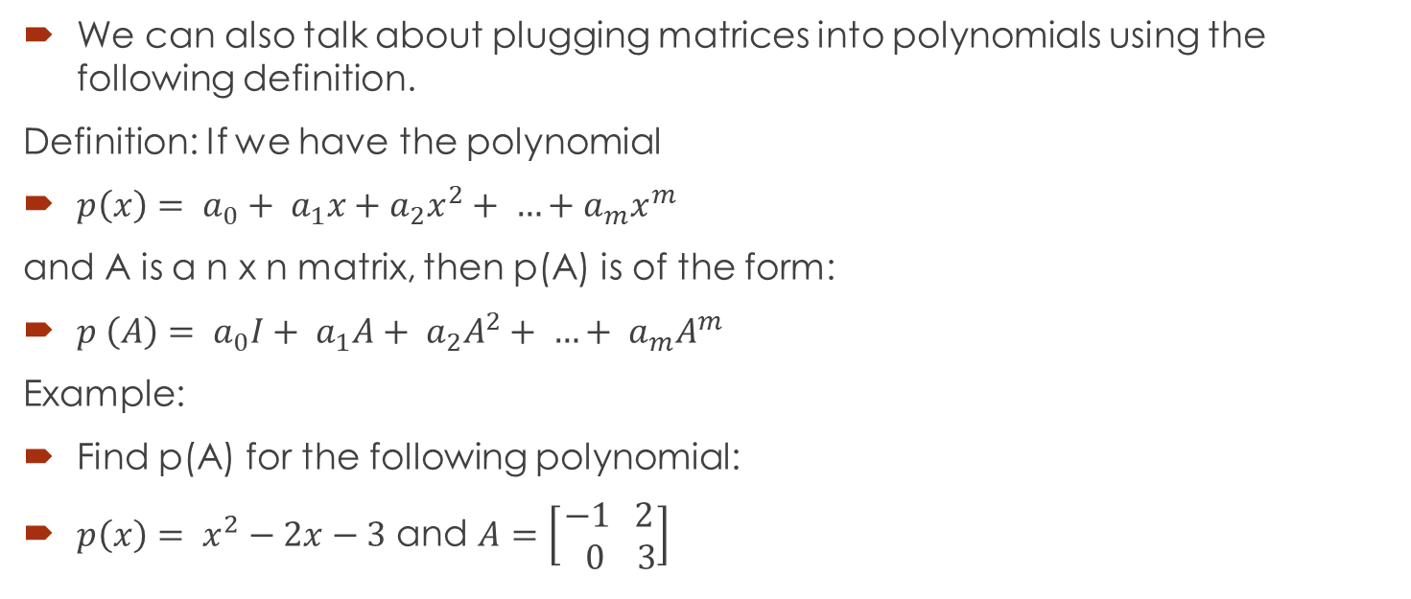
Matrix polynomials

Slide 25
Application
Modeling with Linear Systems

Slide 26
Modeling with Linear Systems
Linear equations—often containing hundreds or even thousands of variables—occur frequently in the applications of algebra to the sciences and to other fields.
For now, let’s consider an example that involves only three variables.

Slide 27
Nutritional Analysis
A nutritionist is performing an experiment on student volunteers.
He wishes to feed one of his subjects a daily diet that consists of a combination of three commercial diet foods: MiniCal LiquiFast SlimQuick

Slide 28
Nutritional Analysis
For the experiment, it’s important that, every day, the subject consume exactly:
500 mg of potassium
75 g of protein
1150 units of vitamin D

Slide 29
Nutritional Analysis
The amounts of these nutrients in one ounce of each food are given here.
How many ounces of each food should the subject eat every day to satisfy the nutrient requirements exactly?

Slide 30
Nutritional Analysis
Let x, y, and z represent the number of ounces of MiniCal, LiquiFast, and SlimQuick, respectively, that the subject should eat every day.

Slide 31
Nutritional Analysis
This means that he will get:
50x mg of potassium from MiniCal
75y mg from LiquiFast
10z mg from SlimQuick
This totals 50x + 75y + 10z mg potassium.

Slide 32
Nutritional Analysis
Based on the requirements of the three nutrients, we get the system

Slide 33
Nutritional Analysis
Dividing the first equation by 5 and the third by 10 gives the system showed below.
We can solve this using Gaussian or Gauss - Jordan elimination.
Alternatively, we could use SCILAB to find the reduced row-echelon form of the augmented matrix of the system.

Slide 34
Lab application Use scilab to solve the system
Answer:
x = 5, y = 2, z = 10

Slide 35
Nutritional Analysis Using System of Linear Equations
A more practical application might involve dozens of foods and nutrients rather than just three.
Such problems lead to systems with large numbers of variables and equations.
Computers are essential for solving such large systems.

Slide 36

Question 1
Given the matrices below, perform the indicated operations (if possible).
$A= \left[\begin{aligned}2 1 \\ 3 5\end{aligned}\right]$; $B= \left[\begin{aligned}−2 3 \\ 4 −1\end{aligned}\right];$ C = $\left[\begin{aligned}3 0 1 \\ 2 1 5 \\ −1 2 3\end{aligned}\right]$; D = $\left[\begin{aligned}0 1 \\ 2 5 \\ 8 1\end{aligned}\right]$

Slide 39

d) $−4/7×A^{T}$
e) $C×D$
f) $D×C$

Slide 40

g) $tr(C)$
h) $5C^{2}$

Slide 42

Question 2
$A= \left[\begin{aligned}4 6 \\ 1 9\end{aligned}\right]$ ; $B= \left[\begin{aligned}2 −3 1 \\ −2 0 5\end{aligned}\right]$; $C= \left[\begin{aligned}2 −3 1 \\ −2 0 5 \\ −1 3 4\end{aligned}\right]$;

Slide 43

$A ×(B × C)$

